Slide 1
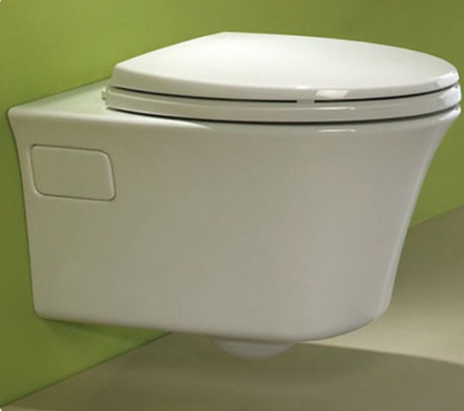
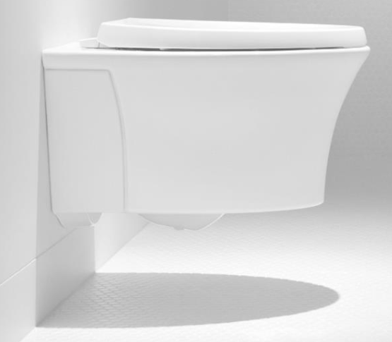
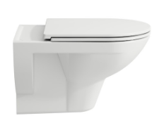
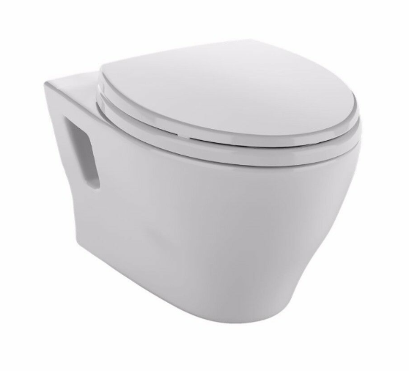
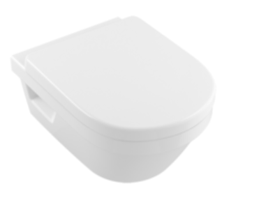
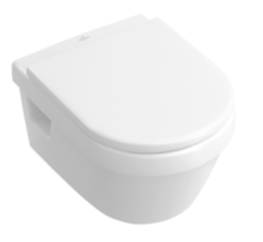
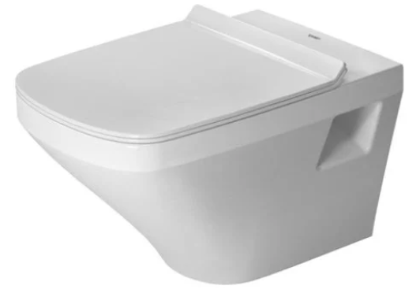
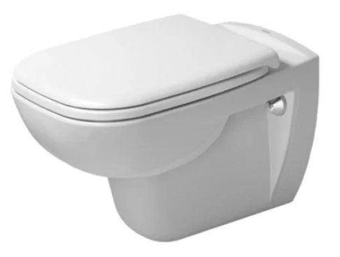
Wall Hung Bowls – simple bolt-on design.
Easy install on first attempt, usually entry level bowls
TOTO Aquia Wall Hung Bowl
CT418F#01 1.6gpf
CT428 “EP” 1.28gpf
TOTO Maris wall hung bowl
CT484CEFG#01
Kohler Veil Wall Hung Bowl
K-6299-0
Laufen Pro
820950
Duravit Rimless Bowl
253809
Duravit D-Code
253509
Villeroy & Boch
4866UR
Villeroy & Boch
5684U1

Slide 2
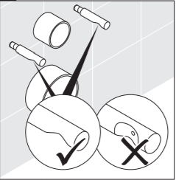
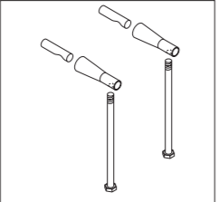
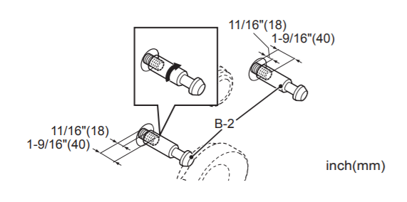
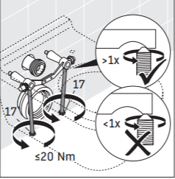
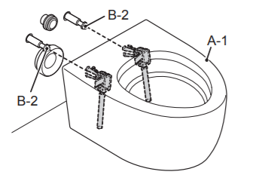
Concealed (Skirted) wall hung bowl install methods
Sleek designs, but are typically more difficult and time consuming to install
Duravit concealed connection
Fitting installs on carrier rods,
then bolt bowl to the fitting
TOTO concealed connection
Fitting installs on carrier rods,
then bolt bowl to the fitting
when bolt tightens to fitting
bowl should tighten toward wall

Slide 3
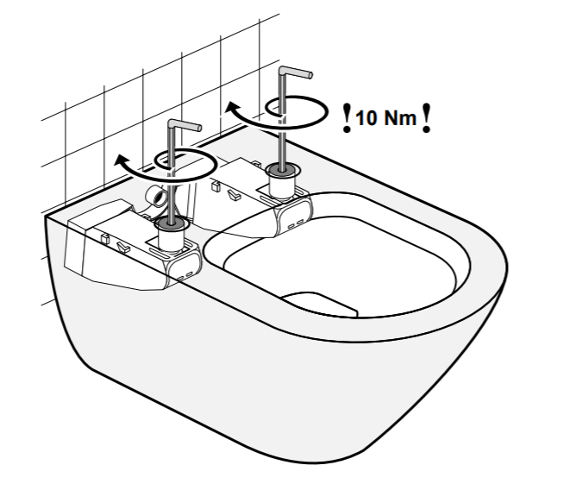
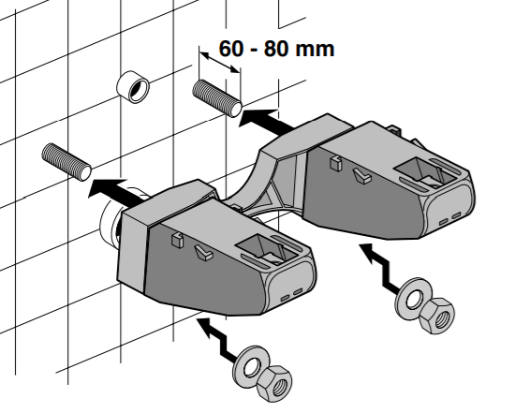
Concealed bowl connection simplified for installers
Villeroy & Boch Suprafix Video
https://youtu.be/KNSLWgb1fVM
6 V&B Suprafix models available
Bolt the bowl to the arms.
Cam-effect tightens bowl to wall.
Bolt V&B provided arms to carrier rods

